Slide 1

Dissertation Stage – 1 Presentation
Transformer-Driven Visual Question Answering
By
Saurabh Madake
712352023
Guided by
Prof. A. B. Patil
COEP Tech Pune
COEP Technological University
A Unitary Public University of Govt. of Maharashtra
Formerly College of Engineering Pune

Slide 2
Index
Introduction
Current Implementation Status
Architecture
Timeline chart
COEP Technological University
A Unitary Public University of Govt. of Maharashtra
Formerly College of Engineering Pune

Slide 3
Introduction
Visual Question Answering (VQA) is a field that bridges computer vision and natural language processing (NLP) to enable machines to understand and respond to questions about visual content.
It is also known as an AI Complete task.
The significance of VQA lies in its potential applications, such as assisting visually impaired individuals, enhancing human computer interactions, etc.
Unlike traditional methods which required a separate pipeline for textual and visual data, recent development in transformers like LXMERT have revolutionize this process.
COEP Technological University
A Unitary Public University of Govt. of Maharashtra
Formerly College of Engineering Pune

Slide 4
Current Implementation Status
Work Completed to Date
Literature Review
Conducted a thorough review of research papers and existing implementations of LXMERT for VQA tasks.
Created a detailed survey paper that that summarizes and analyses existing research on topic
Environment Setup
Configured a development environment using Visual Studio Code with CUDA support to accelerate model training on an NVIDIA GTX 1650 GPU.
Dataset Preparation
Downloaded and analyzed the VQA v2.0 dataset and Visual Genome datasets.
Pre-processed the image features using a Faster R-CNN model, saved in a .pkl file to overcome memory and computational limitations.
COEP Technological University
A Unitary Public University of Govt. of Maharashtra
Formerly College of Engineering Pune

Slide 5
Challenges Faced
Hardware Constraints: Encountered memory crashes in Visual Studio Code due to the size of the datasets during loading.
Dataset Issues: Ensuring alignment of visual and textual modalities during preprocessing required additional debugging.
Decisions Made
Opted for separate training loops for VQA v2.0 and Visual Genome datasets to better manage resource constraints and dataset complexity.
Prioritized preprocessing to streamline training on limited hardware resources.
COEP Technological University
A Unitary Public University of Govt. of Maharashtra
Formerly College of Engineering Pune

Slide 6
Work to be Done
Implementation of the Model Pipeline
Integrating the Hugging Face transformers library and PyTorch framework to build and evaluate the LXMERT model.
Model Training
Begin training the LXMERT model on the preprocessed VQA v2.0 data.
Integration with Visual Genome Dataset
Preprocess and align the Visual Genome dataset using the existing pipeline.
Train the model on Visual Genome data, leveraging the insights from VQA v2.0 training.
Optimization
Experiment with hyperparameter tuning to improve performance.
UI Development
Design a simple web-based interface for inputting images and questions, displaying answers generated by the model.

Slide 7
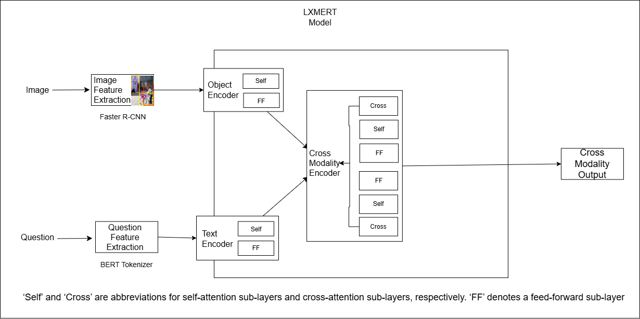
Architecture
COEP Technological University
A Unitary Public University of Govt. of Maharashtra
Formerly College of Engineering Pune

Slide 8
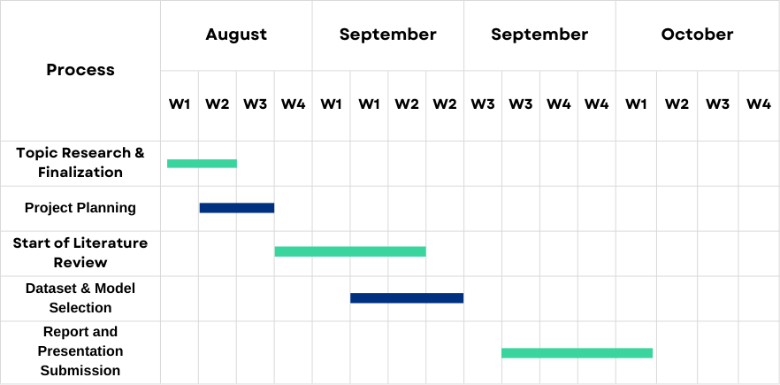
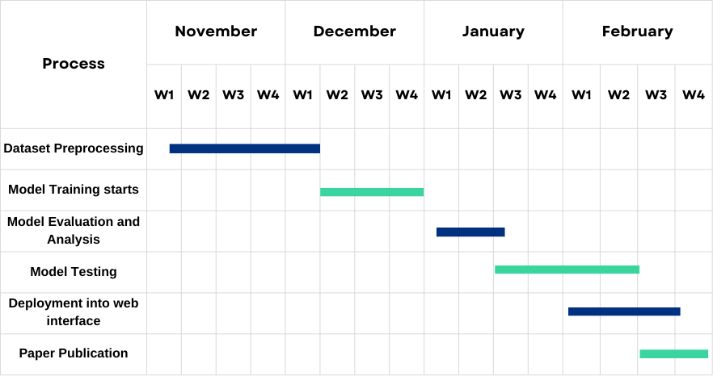
Timeline
COEP Technological University
A Unitary Public University of Govt. of Maharashtra
Formerly College of Engineering Pune

Slide 9
THANK YOU !
COEP Technological University
A Unitary Public University of Govt. of Maharashtra
Formerly College of Engineering Pune

